Slide 1
Sanjivani International School
Witheridge C of E Academy
Our partnership journey
Notes:
HN to talk about:
* The importance of the international curriculum at Witheridge
* British Council Connecting Classrooms project funding, and finding SIS India
the challenges of a pandemic and school closures on developing a partnership
The success of the partnership so far

Slide 2

Google Meet: Live link
What have you most enjoyed about working with our partner school?
What is the most interesting thing you have you learnt through our partnership?
How has our partnership motivated you in your learning?
Notes:
2 children

Slide 3
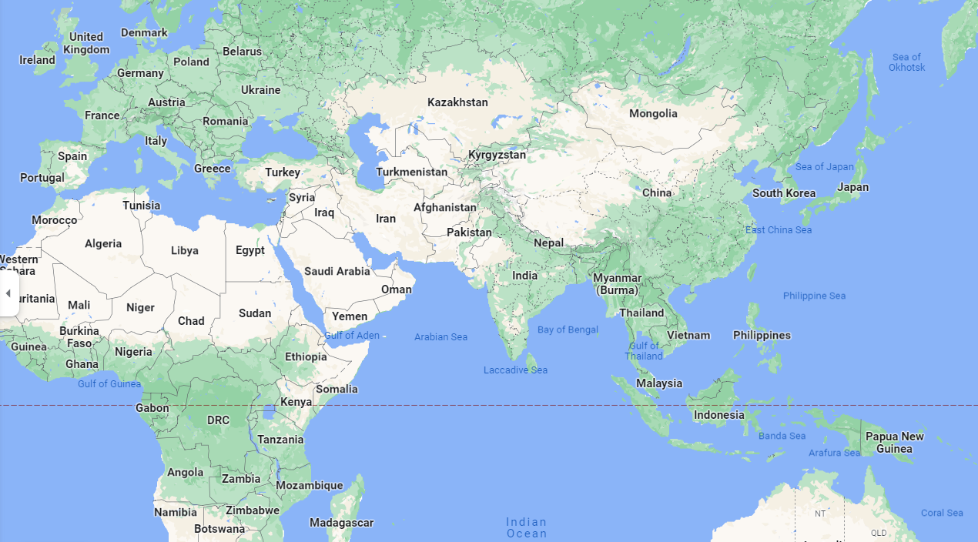
An Introduction to Sanjivani International School
Notes:
2 children:
Location
Similarities and differences to Witheridge – e.g. urban v rural

Slide 4
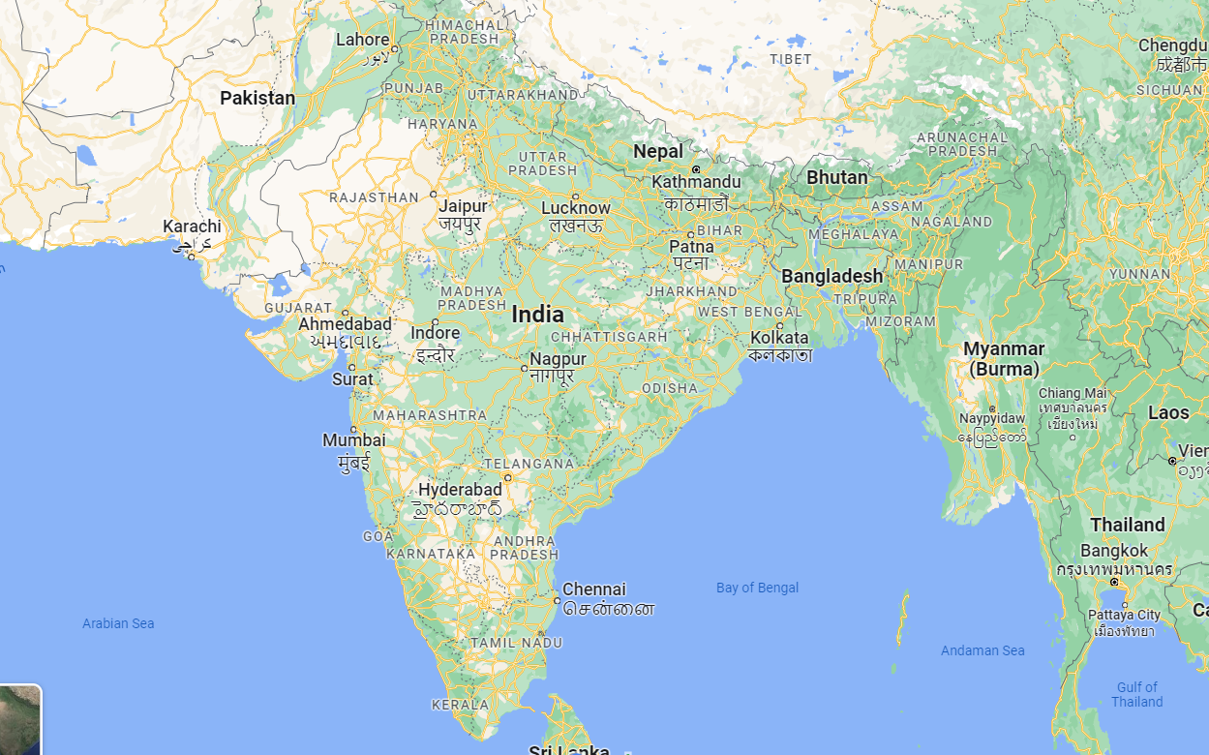
An Introduction to Sanjivani International School
Notes:
2 children:
Location
Similarities and differences to Witheridge

Slide 5
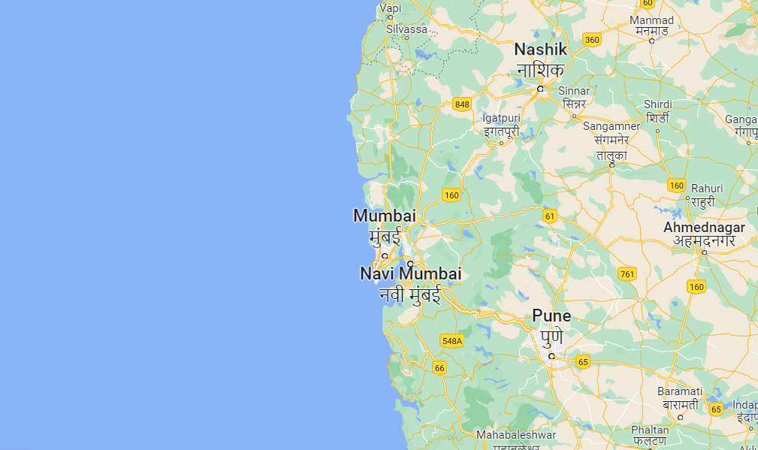
An Introduction to Sanjivani International School
Notes:
2 children:
Location
Similarities and differences to Witheridge

Slide 6
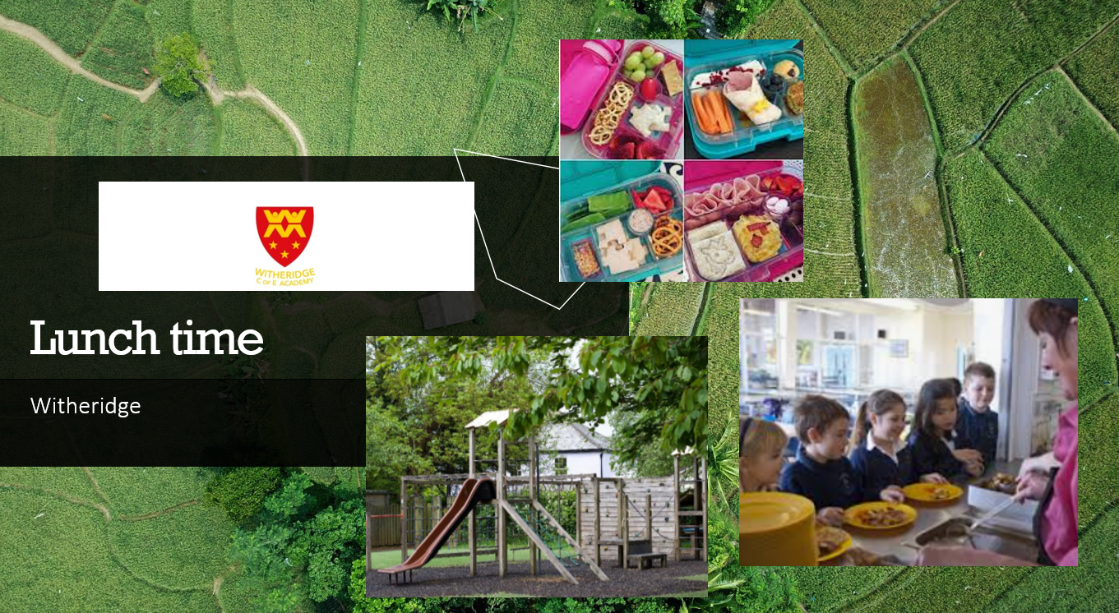
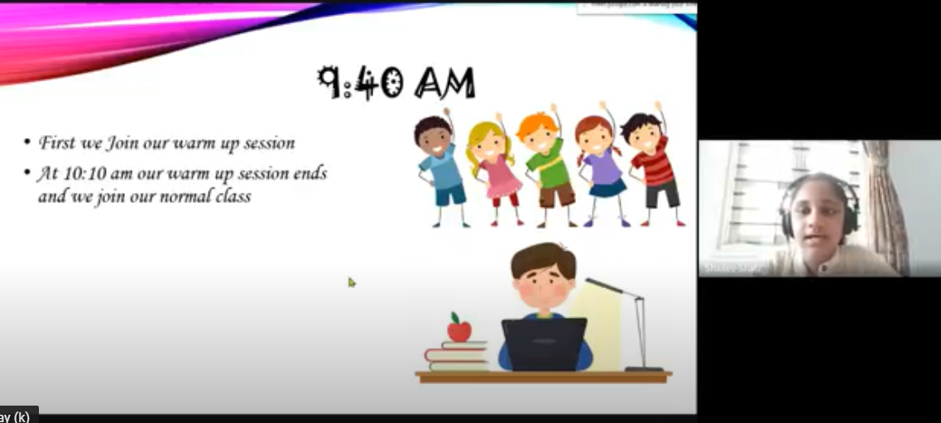
Getting to know you
Notes:
2 children

Slide 7

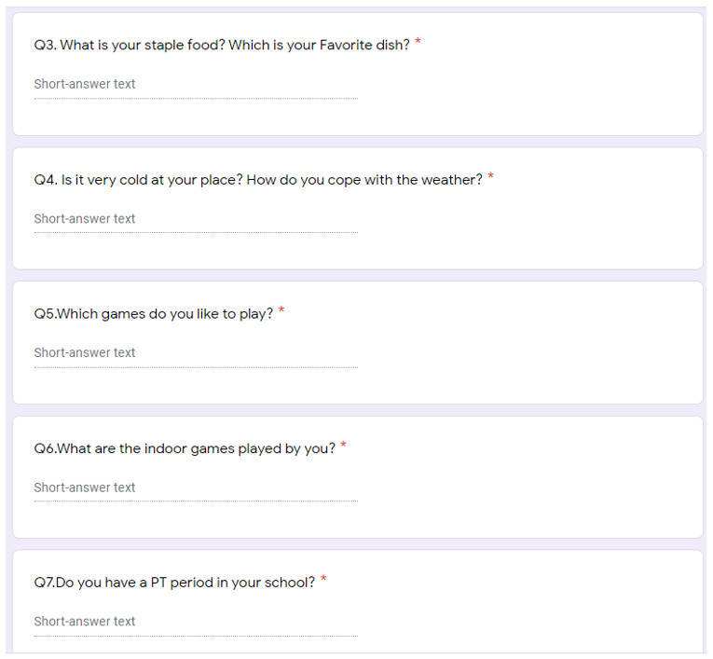
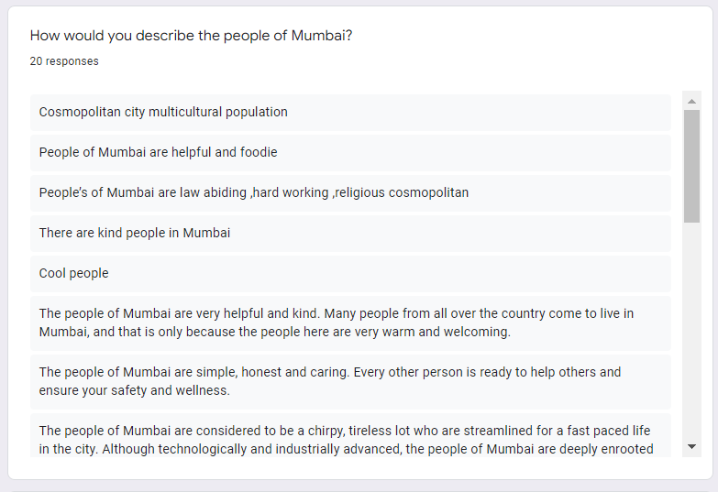
Getting to know you MORE!
Notes:
2 children

Slide 8

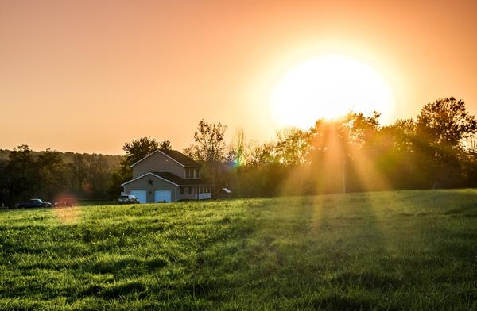
Learning Hindi
Namaste
Suprabhat
Shubh Dopahar
Shubh Sandhya
Shubh Ratri
Notes:
3 children
Teach visitors and others some Hindi?

Slide 9
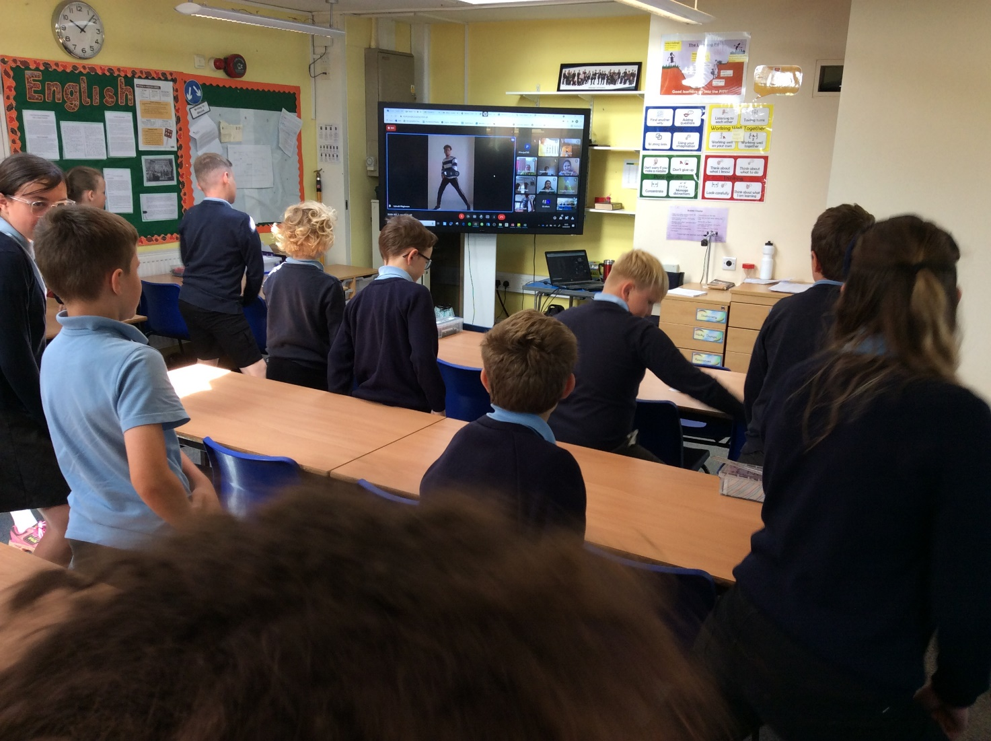
Singing and Dancing
Hum Honge Kumyab
Notes:
2 child introduce and explain
Class 4 to sing live, with backing video

Slide 10

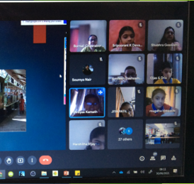

National Parks
Learning about a National Park close to Witheridge
Sharing our knowledge
Compare and contrast
Learning about a National Park nearby Mumbai
Notes:
2 children
Video to play in background on silent?

Slide 11
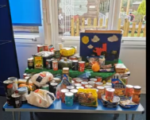
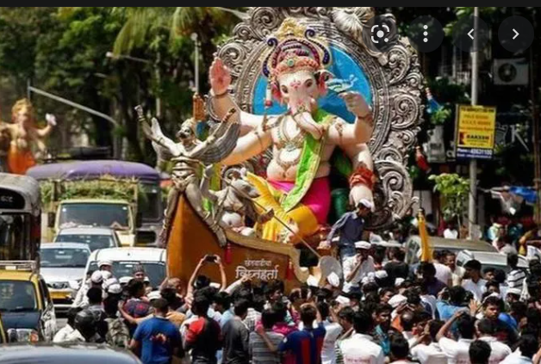
Celebrating Festivals
Harvest
Ganesha Chaturthi
Notes:
2 child introduce video

Slide 12
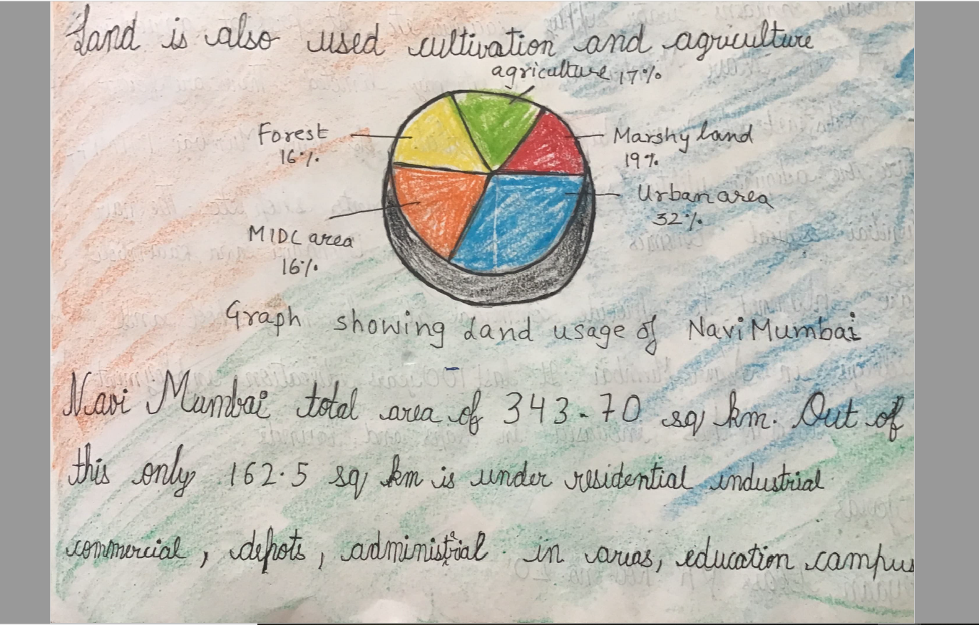
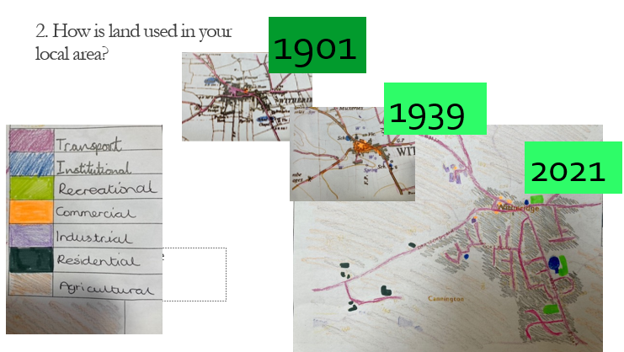
Land Use Project: Video
Witheridge
Mumbai
Notes:
Holly and Owen

Slide 13

United Nations
Sustainable development goals
Notes:
2 child to introduce

Slide 14
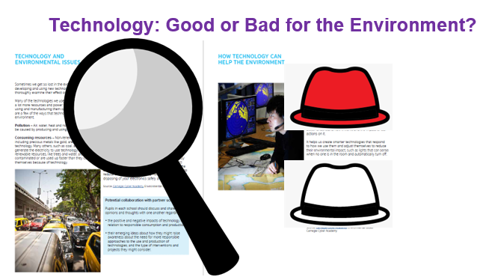
Responsible Consumption – Thinking Hats
Notes:
2 children to talk about hats

Slide 15
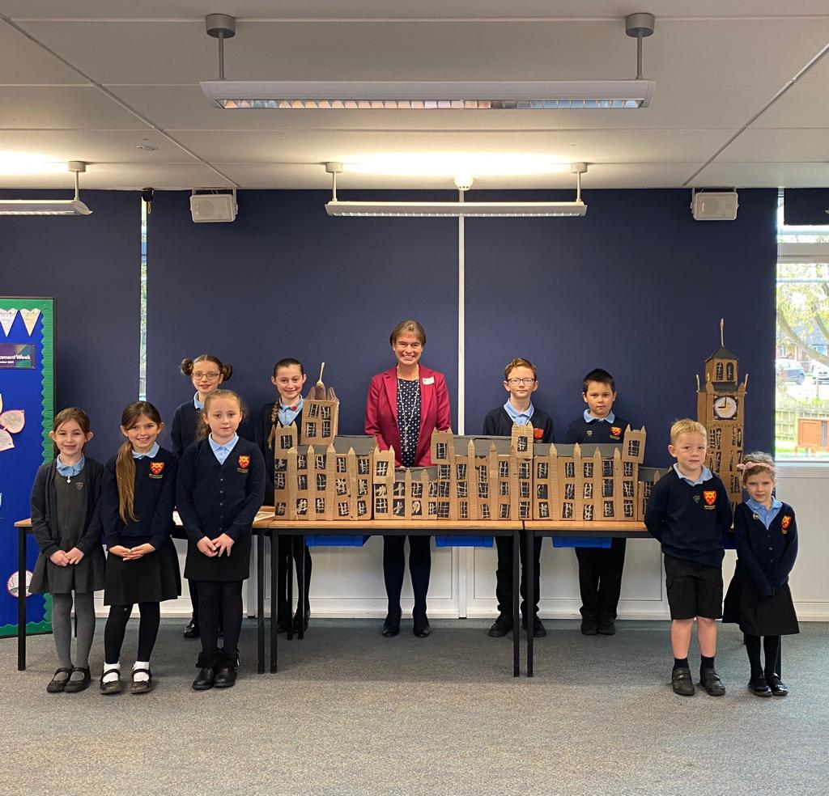
Responsible Consumption – Our Leaders
Notes:
1 child

Slide 16

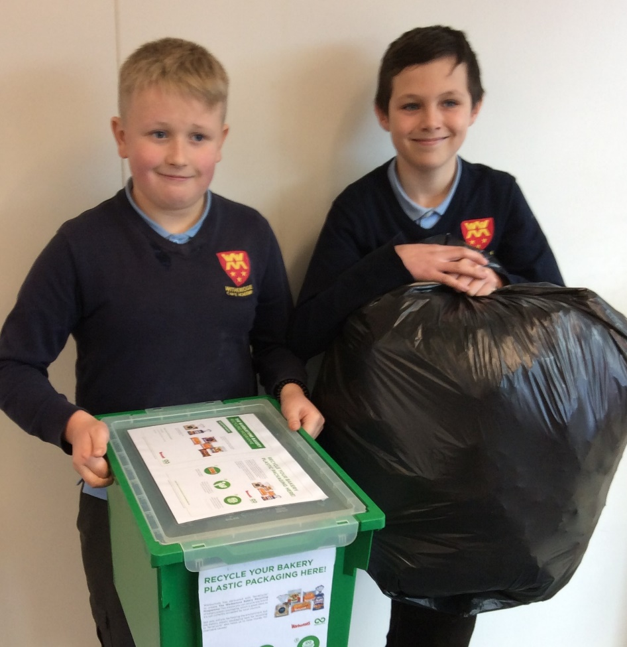
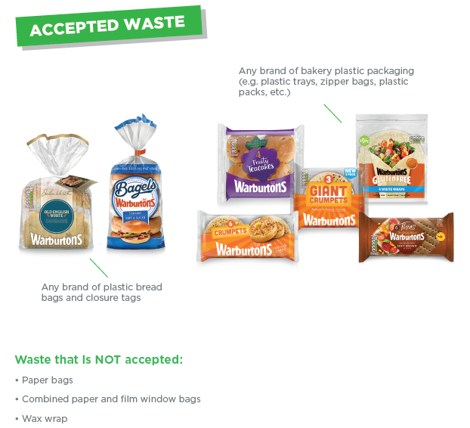
Responsible Consumption – Our School
Notes:
George and Owen

Slide 17
Responsible Consumption – Ourselves
https://youtu.be/8LXp49nWAtY
Notes:
1 child to introduce the video

Slide 18

International School Award

Slide 19


Next steps
Mumbai
Sustainable Development
Witheridge
Notes:
Involvement of younger children – Y3/4 email pen pals; Y1/2 sharing songs and dances

Slide 20
SIS India
Witheridge C of E Academy

